Slide 1
ARTIFICIAL INTELLIGENCE
4
Handayani Tjandrasa

Slide 2
Constraint Satisfaction Problems (CSP)

Slide 3
Constraint satisfaction problems
Aplikasi: scheduling, robot planning, floor planning, map coloring, puzzle, cryptography, dll
Dideskripsikan oleh himpunan variabel, domain nilai dari masing2 variabel, batasan (constraint) kombinasi nilai dari 2 variabel
Mempunyai solusi bila tiap variabel dapat diberi nilai yang memenuhi batasan (consistent assignment)

Slide 4
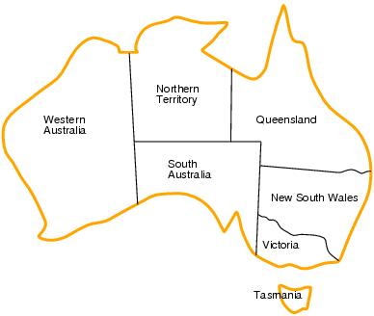
Contoh: Map coloring
Variables: WA, NT, Q, NSW, V, SA, T
Domains: D_{i}={red,green,blue}
Constraints:
Daerah yang bersebelahan mempunyai warna yang berbeda

Slide 5
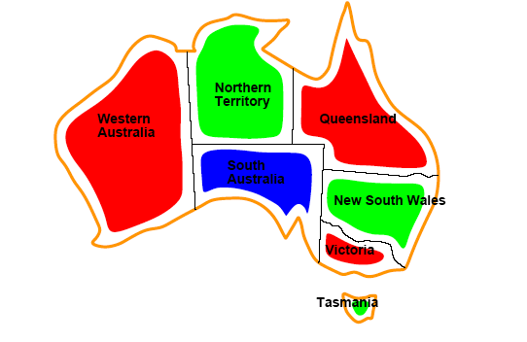
Map coloring
Solusi: nilai untuk tiap variabel yang memenuhi batasan constraints), misal,
{WA=red,NT=green,Q=red,NSW=green,V=red,SA=blue,T=green}

Slide 6
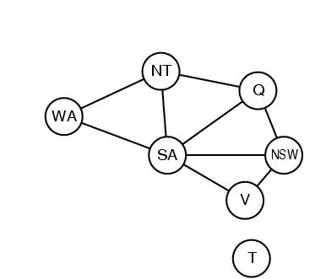
Constraint graph

Slide 7
Macam2 batasan
Batasan unary melibatkan 1 variabel, misal SA ≠ red.
Batasan binary melibatkan pasangan variabel, misal SA ≠ WA.
Batasan order tinggi melibatkan 3 atau lebih variabel.
Persoalan optimisasi (cost) dengan batasan.
CSP adalah komutatif.

Slide 8
Contoh penelusuran solusi dengan Backtracking

Slide 9
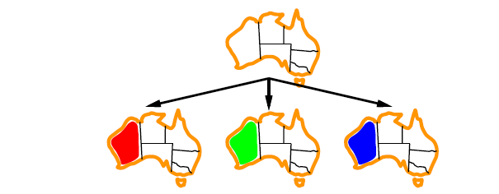
Contoh Backtracking

Slide 10
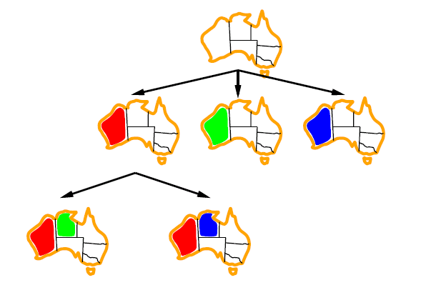
Contoh Backtracking

Slide 11
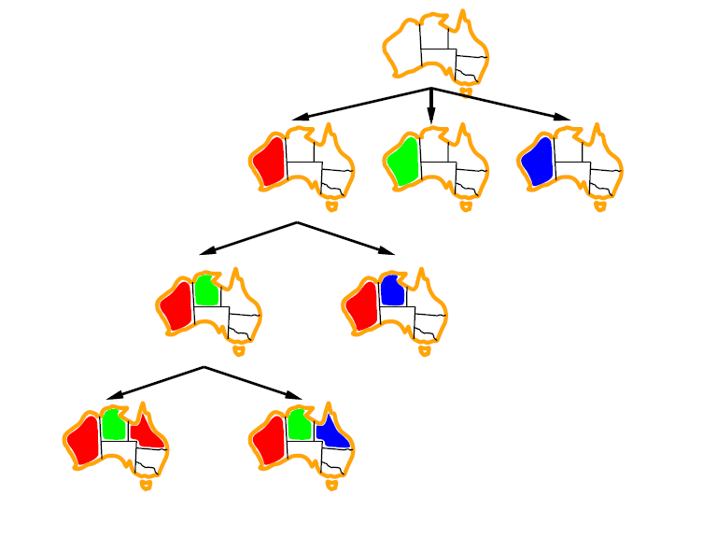
Contoh Backtracking

Slide 12
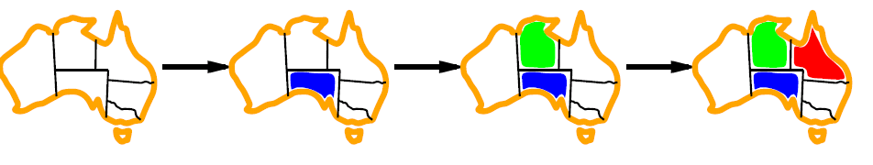
Degree heuristic
Pilih variabel yang paling banyak terlibat batasan dengan variabel lainnya (paling sedikit mempunyai langkah yang diperbolehkan)

Slide 13
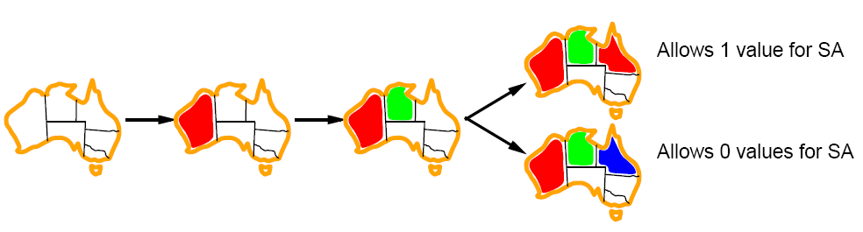
Least constraining value
Untuk suatu variabel yang diberikan, pilih nilai yang paling sedikit membatasi untuk variabel berikutnya yang akan diberi nilai

Slide 14
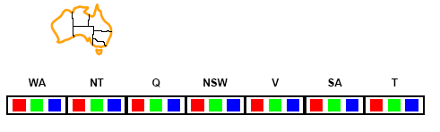
Forward checking
Menjelajahi lebih dulu nilai2 yang diperbolehkan untuk variabel2 yang akan dinilai guna menghindari kegagalan yang mungkin terjadi. Penelusuran dihentikan bila ada variabel yang tidak mempunyai nilai legal.

Slide 15
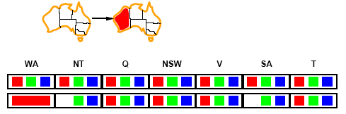
Forward checking
Bila {WA=red}, maka NT dan SA tidak boleh nilai tersebut

Slide 16
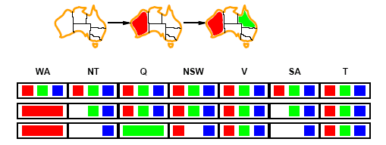
Forward checking
Bila {Q=green}, maka NT, NSW, Dan SA tidak dapat memiliki nilai tersebut.
Berikutnya salah satu dari NT dan SA akan diberi nilai.

Slide 17
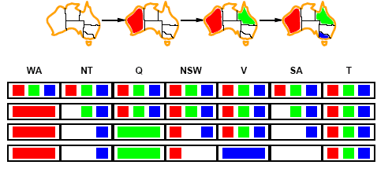
Forward checking
BIla V diberi nilai biru, maka proses penilaian menjadi inconsistent dengan batasan dan backtracking dapat terjadi.

Slide 18
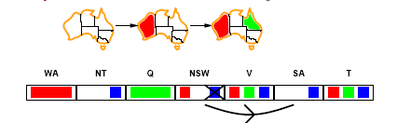
Arc consistency
X → Y adalah konsisten hanya bila untuk setiap nilai x dari X, ada nilai y yang diperbolehkan ( pada gambar, dengan menghapus biru dari NSW)

Slide 19
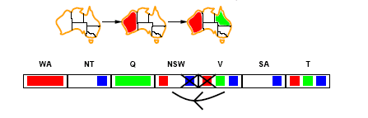
Arc consistency
Berikutnya hilangkan merah dari V

Slide 20
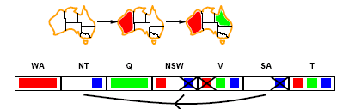
Arc consistency
Dapat mendeteksi kegagalan lebih cepat dari pada FC

Slide 21
K-consistency
CSP adalah k-consistent bila untuk tiap himpunan variabel (k-1) yang dapat diberi nilai legal, selalu dapat diberikan nilai legal untuk variabel ke-k.
Contoh: 1-consistency atau node-consistency, 2-consistency atau arc-consistency, 3-consistency atau path-consistency.

Slide 22
Contoh lain: graph coloring

Slide 23

Contoh dibawah menunjukkan ada arc consistency tetapi tidak ada solusi. Jadi persyaratan arc consistency saja tidak cukup.
Ada arc consistency tapi ada 2 solusi, BRG dan BGR

Slide 24
Penelusuran dengan Backtracking (dengan depth-first search)

Slide 25
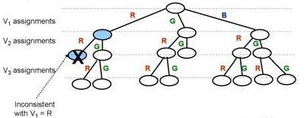
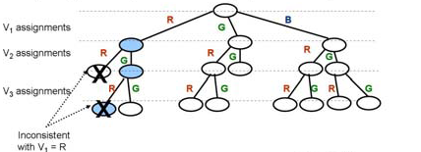

Slide 26

Backtracking dengan Forward Checking (BT-FC)

Slide 27

Lanjutan
Solusi: BRG dan BGR

Slide 28
Game Search: - Minimax Seach - Alpha-beta Pruning

Slide 29
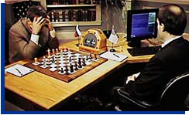
Game playing
Games. Why?
Minimax search
Alpha-beta pruning
Garry Kasparov and Deep Blue, 1997

Slide 30
Some games:
Ball games
Card games
Board games
Computer games
...

Slide 31
Why study board games ?
Abstract and pure form of competition that seems to require intelligence
Easy to represent the states and actions
Very little world knowledge required !
Game playing is a special case of a search problem, with some new requirements.

Slide 32
Game playing
Game playing is not like this.
The opponent introduces uncertainty.
The opponent also wants to win
Game Playing has been studied for a long time
Babbage (tic-tac-toe)
Turing (chess)

Slide 33
Why study board games ?
Game playing research has contributed ideas on how to make the best use of time to reach good decisions, when reaching optimal decisions is impossible.
These ideas are applicable in tackling real-world search problems.
Our limit here: 2-person games, with no chance

Slide 34
Why new techniques for games?
We don’t know the opponents move !
The size of the search space:
Chess : ~15 moves possible per state, 80 ply
15⁸⁰ nodes in tree
Go : ~200 moves per state, 300 ply
200³⁰⁰ nodes in tree
Game playing algorithms:
Search tree only up to some depth bound
Use an evaluation function at the depth bound
Propagate the evaluation upwards in the tree

Slide 35
Types of games
Deterministic
Chance
Perfect information
Chess, draughts, go, othello, tic-tac-toe
Backgammon, monopoly
Imperfect information
Bridge, poker, scrabble

Slide 36
Game Playing - Chess
Shannon - March 9th 1949 - New York
Size of search space (10¹²⁰ - average of 40 moves)
200 million positions/second = 10¹⁰⁰ years to evaluate all possible games
Searching to depth = 40, at one node per microsecond it would take 10⁹⁰ years to make its first move

Slide 37
Game Playing - Chess
1957 - Newell and Simon predicted that a computer would be chess champion within ten years
Simon : “I was a little far-sighted with chess, but there was no way to do it with machines that were as slow as the ones way back then”
1958 - First computer to play chess was an IBM 704 - about one millionth capacity of deep blue.
1967 : Mac Hack competed successfully in human tournaments
1983 : “Belle” obtained expert status from the United States Chess Federation
Mid 80’s : Scientists at Carnegie Mellon University started work on what was to become Deep Blue.
Project moved to IBM in 1989

Slide 38
Game Playing - Chess
May 11th 1997, Gary Kasparov lost a six match game to Deep blue
3.5 to 2.5
Two wins for deep blue, one win for Kasparov and three draws

Slide 39
Game Playing - Checkers (draughts)
Arthur Samuel - 1952
Written for an IBM 701
1954 - Re-wrote for an IBM 704
10,000 words of main memory
Added a learning mechanism that learnt its own evaluation function
Learnt the evaluation function by playing against itself
After a few days it could beat its creator
…. And compete on equal terms with strong human players
Jonathon Schaeffer - 1996
Developed Chinook

Slide 40
Game Playing - Checkers (draughts)
Chinook
Uses Alpha-Beta search
Plays a perfect end game by means of a database
In 1992 Chinook won the US Open
….. And challenged for the world championship
Dr Marion Tinsley, had been world championship for over 40 years
… only losing three games in all that time
Against Chinook she suffered her fourth and fifth defeat
….. But ultimately won 21.5 to 18.5

Slide 41
Game Playing - Checkers (draughts)
In August 1994 there was a re-match but Marion Tinsley withdrew for health reasons
Chinook became the official world champion
Schaeffer claimed Chinook was rated at 2814
The best human players are rated at 2632 and 2625
Chinook did not include any learning mechanism

Slide 42
Game Playing - Checkers (draughts)
Kumar - 2000
“Learnt” how to play a good game of checkers
The program used a population of games with the best competing for survival
Learning was done using a neural network with the synapses being changed by an evolutionary strategy
The best program beat a commercial application 6-0
The program was presented at CEC 2000 (San Diego) and remain undefeated

Slide 43
Game Playing - Minimax
Game Playing: An opponent tries to thwart your every move
1944 - John von Neumann outlined a search method (Minimax) that maximised your position whilst minimising your opponents
In order to implement we need a method of measuring how good a position is.
Often called a utility function (or payoff function)
e.g. outcome of a game; win 1, loss -1, draw 0
Initially this will be a value that describes our position exactly

Slide 44
Game Playing - Minimax
Restrictions:
2 players: MAX (computer) and MIN (opponent)
deterministic, perfect information
Select a depth-bound (say: 2) and evaluation function
MAX
Select
this move
- Construct the tree up till
the depth-bound
3
- Compute the evaluation
function for the leaves
MIN
2
1
3
- Propagate the evaluation
function upwards:
- taking minima in MIN
MAX
2
5
3
1
4
4
3
- taking maxima in MAX

Slide 45
Game Playing - Minimax example
MAX
1
A
Select this move
MIN
1
B
-3
C
MAX
4
D
1
E
2
F
-3
G
4
-5
-5
1
-7
2
-3
-8
= terminal position
= agent
= opponent

Slide 46
Alpha-Beta Pruning
Generally applied optimization on Mini-max.
Instead of:
first creating the entire tree (up to depth-level)
then doing all propagation
Interleave the generation of the tree and the propagation of values.
Point:
some of the obtained values in the tree will provide information that other (non-generated) parts are redundant and do not need to be generated.

Slide 47
Alpha-Beta idea:
Principles:
generate the tree depth-first, left-to-right
propagate final values of nodes as initial estimates for their parent node.
MAX
≥2
- The MIN-value (1) is already
smaller than the MAX-value of the parent (2)
- The MIN-value can only
decrease further,
MIN
≤2
=2
≤1
- The MAX-value is only allowed to increase,
- No point in computing further below this node
MAX
2
5
1

Slide 48
Terminology:
- The (temporary) values at MAX-nodes are ALPHA-values
- The (temporary) values at MIN-nodes are BETA-values
MAX
≥2
Alpha-value
Beta-value
MIN
≤2
=2
≤1
MAX
2
5
1

Slide 49
The Alpha-Beta principles (1):
- If an ALPHA-value is larger or equal than the Beta-value of a descendant node:
stop generation of the children of the descendant
MAX
≥2
Alpha-value
≥
MIN
≤2
=2
≤1
Beta-value
MAX
2
5
1

Slide 50
The Alpha-Beta principles (2):
- If an Beta-value is smaller or equal than the Alpha-value of a descendant node:
stop generation of the children of the descendant
MAX
≥2
MIN
≤2
=2
≤1
Beta-value
≥
MAX
Alpha-value
2
5
3

Slide 51
Alpha-Beta Pruning example
MAX
A
MIN
B
C
<=6
MAX
D
E
6
>=8
H
I
J
K
6
5
8
= agent
= opponent

Slide 52
Alpha-Beta Pruning example
>=6
A
MAX
MIN
B
C
6
<=2
MAX
D
E
F
G
6
>=8
2
H
I
J
K
L
M
6
5
8
2
1
= agent
= opponent

Slide 53
Alpha-Beta Pruning example
>=6
A
MAX
MIN
B
C
6
2
MAX
D
E
F
G
6
>=8
2
H
I
J
K
L
M
6
5
8
2
1
= agent
= opponent

Slide 54
Alpha-Beta Pruning example
MAX
6
A
MIN
B
C
6
2
beta cutoff
MAX
D
E
F
G
6
>=8
alpha cutoff
2
H
I
J
K
L
M
6
5
8
2
1
= agent
= opponent

Slide 55
Mini-Max with α−β at work:
≥ 4
16
≥ 5
31
= 5
39
MAX
≤ 8
6
≤ 5
23
= 4
15
= 5
30
≤ 3
38
MIN
≥ 8
≥ 2
≥ 1
≥ 1
33
2
10
18
≥ 3
≥ 2
= 8
≥ 4
12
≥ 3
20
25
35
5
≥ 9
8
≥ 9
27
≥ 6
29
= 3
= 4
14
= 5
22
37
MAX
8
7
3
9
1
6
2
4
1
1
3
5
3
9
2
6
5
2
1
2
3
9
7
2
8
6
4
1
3
4
7
9
11
13
17
19
21
24
26
28
32
34
36
11 static evaluations saved !!

Slide 56
“DEEP” cut-offs
- For game trees with at least 4 Min/Max layers:
the Alpha - Beta rules apply also to deeper levels.
≥ 4
≤ 4
≥ 4
≤ 4
≤ 2
4
2

Slide 57
The Gain: Best case:
- If at every layer: the best node is the left-most one
MAX
MIN
MAX
Only THICK is explored

Slide 58
Example of a perfectly ordered tree
21
MAX
21 12 3
MIN
21 24 27
12 15 18
3 6 9
MAX
21 20 19 24 23 22 27 26 25
12 11 10 15 14 13 18 17 16
3 2 1 6 5 4 9 8 7

Slide 59
Best case gain pictured:
# Static evaluations
b = 10
No pruning
100000
10000
Alpha-Beta
Best case
1000
100
10
Depth
1
2
3
4
5
6
7
- Note: algorithmic scale.
- Conclusion: still exponential growth !!
- Worst case??
For some trees alpha-beta does nothing,
For some trees: impossible to reorder to avoid cut-offs

Slide 60
The horizon effect.
Queen lost
Pawn lost
horizon = depth bound
of mini-max
Queen lost
Because of the depth-bound
we prefer to delay disasters, although we don’t prevent them !!
solution: heuristic continuations

Slide 61
Heuristic Continuation
In situations that are identifies as strategically crucial
e.g: king in danger, imminent piece loss, pawn to become as queens, ...
extend the search beyond the depth-bound !
depth-bound

Slide 62
Time bounds:
How to play within reasonable time bounds?
Even with fixed depth-bound, times can vary strongly!
Solution:
Iterative Deepening !!!

Slide 63
Summary
alpha-beta algorithm does the same calculation as minimax, and is more efficient since it prunes irrelevant branches.
usually, the complete game tree is not expanded, search is cut off at some point and an evaluation function calculated to estimate the utility of a state.
So far, for a possibly good and efficient search:
select good search method/technique
provide info/heuristic if possible
apply prune irrelevant branches

Slide 64
TERIMA KASIH

